Slide 1
ASSOCIATION RULE MINING
Renato R. Maaliw III, DIT
College of Engineering & ITSSO
Southern Luzon State University
Lucban, Quezon, Philippines

Slide 2
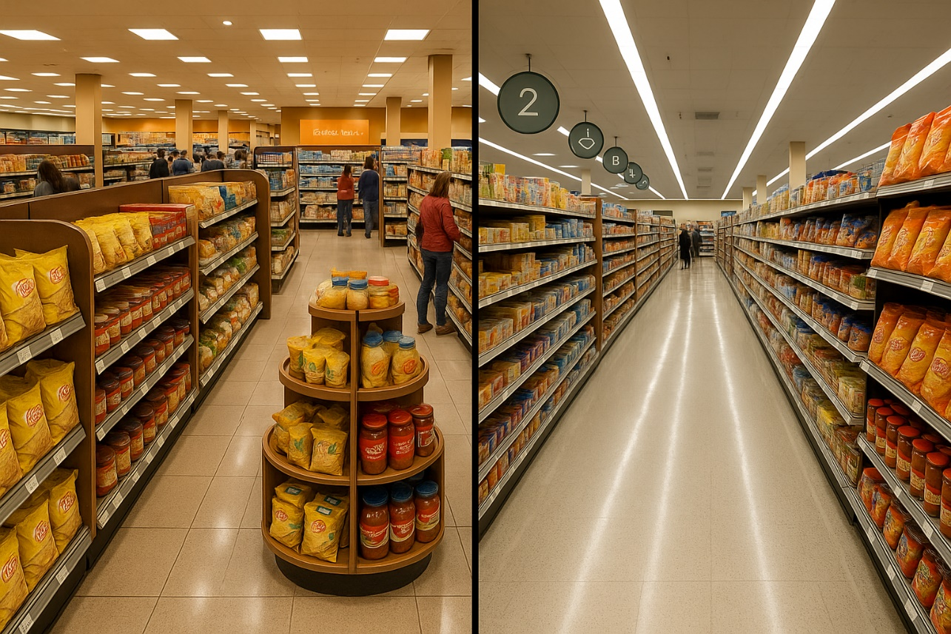
In the 1990s, a major retail chain wanted to better understand customer behavior and optimize their store layouts.
They analyzed their sales data, hoping to uncover patterns that could lead to strategic improvements.
During this analysis, they made an intriguing discovery: there was a strong correlation between the purchase of two items.

Slide 3

Initially, this correlation seemed puzzling.
These two items are not typically associated with each other, and their connection was not immediately obvious.

Slide 4
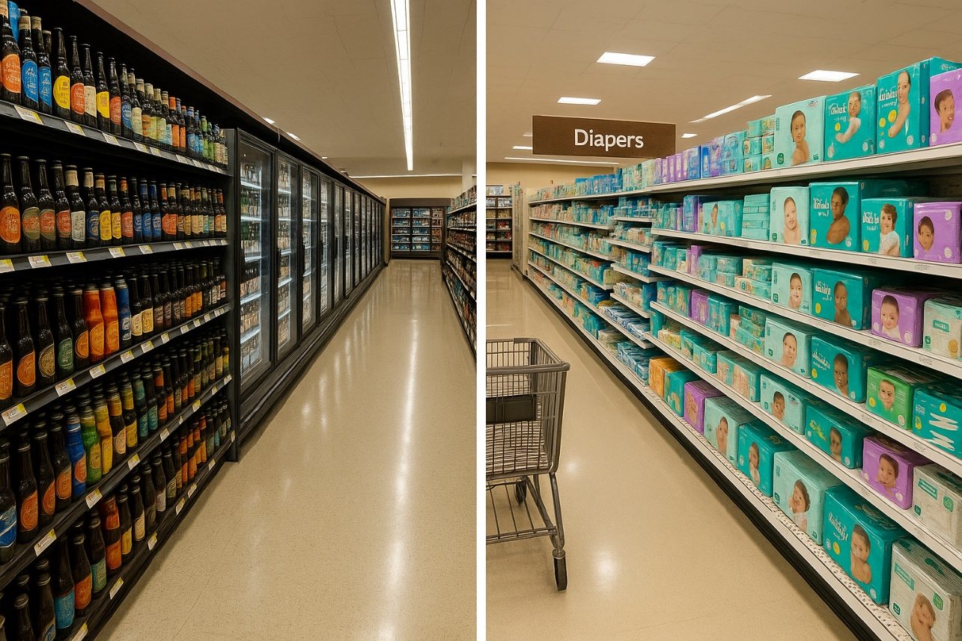
Beer and diapers are not typically associated with each other, and their connection was not immediately obvious.
However, upon further investigation and analysis, the retailer found a compelling explanation.

Slide 5

They examined the shopping patterns of their customers and identified a specific demographic that was responsible for this correlation: young fathers.
These fathers were often responsible for picking up diapers on their way home from work.

Slide 6
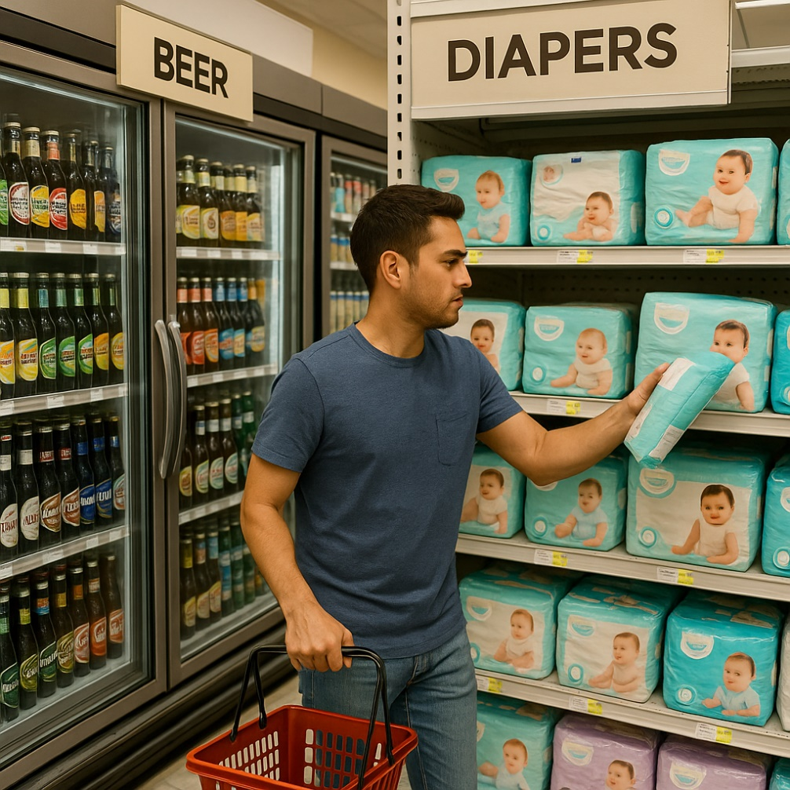
Armed with this newfound insight, the retailer recognized a significant business opportunity.
They decided to leverage the correlation between beer and diapers by strategically placing the products in proximity to each other within their stores.
Beer displays were positioned near the diaper section, making it more convenient for customers to find and purchase both items together.

Slide 7
Association Rule Mining (ARM)
A technique used to uncover interesting relationships, patterns, or associations within large datasets.
Applied in fields such as retail and e-commerce to help understand customer purchasing patterns, detecting anomalies, and making strategic business decisions.

Slide 8
Basic Concepts of ARM
For instance, in a supermarket, ARM might reveal that “customers who buy bread and butter often also buy milk”
If {bread, butter} then {milk}
These rules reveal dependencies and correlations among items, often helping organizations in cross-selling, recommendation systems, and inventory management

Slide 9
Key Terminologies

Slide 10
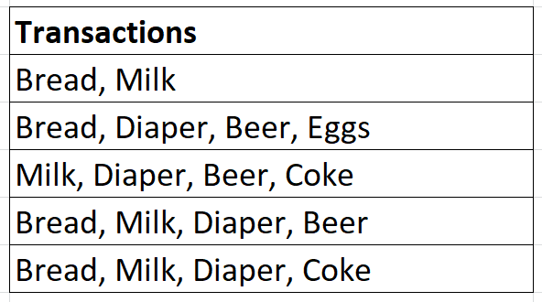
Itemset:
A collection of one or more items:
{Bread}
{Bread, Milk}

Slide 11
K-Itemset:
An itemset containing exactly k-items:
{Bread, Milk} is a 2-itemset
{Bread, Milk, Diaper} is a 3-itemset

Slide 12
Support Count (σ):
The number of transactions that include a particular itemset. For example, if {Bread, Milk} appears in 3 out of 5 transactions, its support count is 3.

Slide 13
Support (s):
The proportion of transactions containing itemset, calculated as support count / total transactions.
For {Milk, Bread} the support would be 3 / 5 = 0.6.

Slide 14
Frequent Itemset:
An itemset whose support meets or exceeds a user-defined minimum support threshold.
If minimum support threshold is set to 0.6, then {Milk, Bread} is a frequent itemset.

Slide 15
Associaton Rules

Slide 16
An Association Rule
It is an implication in the form of X → Y, where:
X and Y are itemsets, with X as the “antecedent” (if – part) and
Y as the “consequent” (then – part)
Example: {Milk, Diaper} → {Beer}
meaning if Milk and Diaper are purchased, Beer is also likely to be purchased

Slide 17
Metrics for Rule Evaluation

Slide 18
Support (s)
How often X and Y occur together, the probability of both itemsets appearing in the same transactions
Support for {Milk, Diaper, Beer}
Support = {Number of transactions containing {Milk, Diaper, Beer} / (Total Transactions)
From the table, 2 / 5 = 0.4

Slide 19
Confidence
Confidence for the rule {Milk, Diaper} → {Beer}
$$Confidence(\{Milk, Diaper\}→\{Beer\})=\frac{Support\left(Milk, Diaper, Beer\right)=(0.4)}{Support\left(Milk, Diaper\right)=(0.6)}$$
Support({Milk, Diaper}) is the number of transactions containing both Milk and Diaper, which appears in 3 transactions (3, 4, 5), 3 / 5 = 0.6
Confidence = 0.4 / 0.6 = 0.67

Slide 20
Lift
Measures how much likely it is to see:
{Beer} with {Milk, Diaper} than it would be to see
{Beer} itself.
$$Lift(Milk, Diaper→Beer)=\frac{Support(Milk, Diaper, Beer)}{Support\left(Milk, Diaper\right) ∗Support(Beer)}$$
2 / 5 = 0.4

Slide 21
Lift
Measures how much likely it is to see:
{Beer} with {Milk, Diaper} than it would be to see
{Beer} itself.
$$Lift(Milk, Diaper→Beer)=\frac{Support(Milk, Diaper, Beer)}{Support\left(Milk, Diaper\right) ∗Support(Beer)}$$
3 / 5 = 0.6

Slide 22
Lift
Measures how much likely it is to see:
{Beer} with {Milk, Diaper} than it would be to see
{Beer} itself.
$$Lift(Milk, Diaper→Beer)=\frac{Support(Milk, Diaper, Beer)}{Support\left(Milk, Diaper\right) ∗Support(Beer)}$$
3 / 5 = 0.6

Slide 23
Lift
Measures how much likely it is to see:
{Beer} with {Milk, Diaper} than it would be to see
{Beer} itself.
$$Lift(Milk, Diaper→Beer)=\frac{Support(Milk, Diaper, Beer)}{Support\left(Milk, Diaper\right) ∗Support(Beer)}$$
2 / 5 = 0.4
3 / 5 = 0.6
3 / 5 = 0.6
Lift = 0.4 / (0.6) * (0.6) = 1.11

Slide 24
Interpretation:
Support of 0.40 indicates that {Milk, Diaper, Beer} appears 40% of all transactions.
Confidence of 0.67 suggests that 67% of transactions containing {Milk, Diaper} also contain {Beer}
Lift of 1.11 means that transactions with {Milk, Diaper} are 1.11 times more likely to include {Beer} than by random chance.

Slide 25
Interpreting Lift Values (L > 1)
A lift of greater than 1 indicates that items in the antecedent and consequent appear together more frequently than would be expected by random chance.
Higher values signify a stronger association:
1.1 to 1.5: Weak positive association
1.6 to 2.0: Moderate positive association
> 2.0: Strong positive association

Slide 26
Interpreting Lift Values (L = 1)
A lift of exactly 1 indicates that the antecedent and consequent are statistically independent. The presence of one item does not affect the likelihood of the other appearing.

Slide 27
Interpreting Lift Values (L < 1)
A lift of less than 1 indicates that the presence of the antecedent actually makes the consequent less likely to occur in the same transaction.
Values further below 1 imply a stronger negative association:
0.75 to 1.0: Weak negative association
0.5 to 0.74: Moderate negative association
> 0.5: Strong negative association

Slide 28
The Apriori Principle

Slide 29
To reduce compuational effort, the Apriori principle states:
“If an itemset is frequent, all its subsets must also be frequent”
This allows us to prune (ignore) itemsets that have infrequent subsets, reducing thee number of itemsets we need to consider

Slide 30
Rule Generation
Once frequent itemsets are identified, rules are generated by partitioning the itemset:
For example, from the itemset {Milk, Diaper, Beer}, possible rules include:
{Milk, Diaper} → {Beer}
{Diaper, Beer} → {Milk}
* Only rules that meet the confidence threshold are retained

Slide 31
Apriori Principle in Action
Suppose we have a transaction database with five transactions and a minimum support threshold of 3 (i.e., an itemset needs to appear in at least 3 transactions to be considered frequent).
Step 1: Identify Frequent 1-Itemsets
Count each item individually across transactions
Bread appears in 4 transactions (1, 2, 4, 5) ➔ frequent
Milk appears in 4 transactions (1, 3, 4, 5) ➔ frequent
Diaper appears in 4 transactions (2, 3, 4, 5) ➔ frequent
Beer appears in 3 transactions (2, 3, 4) ➔ frequent
Coke appears in 2 transactions (3, 5) ➔ not frequent
Eggs appears in 1 transaction (2) ➔ not frequent
Based on the minimum support threshold, only {Bread, Milk, Diaper, Beer} are frequent 1-itemsets. We discard {Coke} and {Eggs} from further consideration.11

Slide 32
Step 2: Identify Frequent 2-Itemsets
Form 2-itemsets using only the frequent 1-itemsets: {Bread, Milk, Diaper, Beer}.
{Bread, Milk} appears in 3 transactions (1, 4, 5) ➔ frequent
{Bread, Diaper} appears in 3 transactions (2, 4, 5) ➔ frequent
{Bread, Beer} appears in 2 transactions (2, 4) ➔ not frequent (pruned)
{Milk, Diaper} appears in 3 transactions (3, 4, 5) ➔ frequent
{Milk, Beer} appears in 2 transactions (3, 4) ➔ not frequent (pruned)
{Diaper, Beer} appears in 3 transactions (2, 3, 4) ➔ frequent
Using the Apriori Principle, we ignore any 3-itemsets that include pruned 2-itemsets {Bread, Beer} and {Milk, Beer} because they contain infrequent subsets.

Slide 33
Step 3: Generate Candidate 3-Itemsets
We form 3-itemsets only from combinations of the frequent 2-itemsets.
{Bread, Milk, Diaper} appears in 3 transactions (4, 5) ➔ frequent
{Milk, Diaper, Beer} appears in 2 transactions (3, 4) ➔ not frequent (pruned)
{Bread, Diaper, Beer} appears in 2 transactions (2, 4) ➔ not frequent (pruned)
Because {Milk, Diaper, Beer} and {Bread, Diaper, Beer} are infrequent, we don’t consider any further supersets of these itemsets.

Slide 34
Pruning Summary
Apriori Principle allows us to skip evaluating itemsets with infrequent subsets.
For example, we didn’t evaluate {Bread, Beer} further because {Bread, Beer} itself was infrequent.
Resulting Frequent Itemsets:
1-itemsets: {Bread}, {Milk}, {Diaper}, {Beer}
2-itemsets: {Bread, Milk}, {Bread, Diaper}, {Milk, Diaper}, {Diaper, Beer}
3-itemsets: {Bread, Milk, Diaper}
This example clearly shows how the Apriori Principle helps reduce the number of calculations by eliminating candidates with infrequent subsets early, making the algorithm more efficient.

Slide 35
Given the following dataset: T1: {A, B, C} T2: {A, B} T3: {A, C} T4: {B, C} T5: {A, B, C}
01. What is the support of itemset
{A, B}?
2/5 = 40%
3/5 = 60%
4/5 = 80%
5/5 = 100%

Slide 36
Given the following dataset: T1: {A, B, C} T2: {A, B} T3: {A, C} T4: {B, C} T5: {A, B, C}
01. What is the support of itemset
{A, B}?
2/5 = 40%
3/5 = 60%
4/5 = 80%
5/5 = 100%

Slide 37
Given the following dataset: T1: {A, B, C} T2: {A, B} T3: {A, C} T4: {B, C} T5: {A, B, C}
What is the support of itemset
{A, B}?
2/5 = 40%
3/5 = 60%
4/5 = 80%
5/5 = 100%
* {A, B} appears in T1, T2, T5 → 3 occurrences; support = 3/5 = 60%

Slide 38
Given the following dataset: T1: {A, B, C} T2: {A, B} T3: {A, C} T4: {B, C} T5: {A, B, C}
02. What is the confidence of rule
{A} → {C}
50%
60%
70%
75%

Slide 39
Given the following dataset: T1: {A, B, C} T2: {A, B} T3: {A, C} T4: {B, C} T5: {A, B, C}
02. What is the confidence of rule
{A} → {C}
50%
60%
70%
75%
Support(A, C) = 3 (T1, T3, T5)
Support(A) = 4 (T1, T2, T3, T5)
Confidence = ¾ = 75%

Slide 40
Given the following dataset: T1: {A, B, C} T2: {A, B} T3: {A, C} T4: {B, C} T5: {A, B, C}
03. What is the lift of rule {A} → {C}
0.75
0.80
0.94
1.20

Slide 41

Given the following dataset: T1: {A, B, C} T2: {A, B} T3: {A, C} T4: {B, C} T5: {A, B, C}
03. What is the lift of rule {A} → {C}
0.75
0.80
0.94
1.20
$$Lift(A→C)=\frac{Support\left(A, C\right)=\frac{3}{5}=0.6}{Support(A)∗Support(C)}$$
0.9375
0.8
0.8

Slide 42
04. Given supports:
s(A,B) = 0.50
s(A,C) = 0.40
s(B,C) = 0.45
s(A,B,C) = 0.35
With min_conf = 0.80, which rule(s) from {A, B, C} pass?
Only {A,B} → C
Only {A,C} → B
Only {B,C} → A
All three

Slide 43
04. Given supports:
s(A,B) = 0.50
s(A,C) = 0.40
s(B,C) = 0.45
s(A,B,C) = 0.35
Compute each confidence:
1. {A, B} → C = conf({A,B} → {C}) = s(A,B,C) = 0.35 / 0.50 = 0.70
2. {A,C} → B = conf({A,C} → {B}) = s(A,B,C) = 0.35 / 0.40 = 0.875
3. {B,C} → A = conf({B,C} → {A}) = s(A,B,C) = 0.35 / 0.45 = 0.77

Slide 44
05. What is the primary goal of the Apriori algorithm
To cluster data points
To calculate the distances between data points
To find frequent item sets
To find associated items based on preset labels

Slide 45
05. What is the primary goal of the Apriori algorithm
To cluster data points
To calculate the distances between data points
To find frequent item sets
To find associated items based on preset labels

Slide 46
07. What is the main input required for the Apriori algorithm
Boolean data
Transactional dataset
Matrix data
Predefined data

Slide 47
07. What is the main input required for the Apriori algorithm
Boolean data
Transactional dataset
Matrix data
Predefined data

Slide 48
08. What is the confidence metric in Apriori
The probability that an item appears in the dataset
The difference between support and lift
The overall quality of association in the dataset
The likelihood of B item occurring given that A has occured

Slide 49
08. What is the confidence metric in Apriori
The probability that an item appears in the dataset
The difference between support and lift
The overall quality of association in the dataset
The likelihood of B item occurring given that A has occurred

Slide 50
09. In which area is the Apriori algorithm most commonly applied
Natural language processing
Image processing
Cluster processing
Market basket analysis

Slide 51
09. In which area is the Apriori algorithm most commonly applied
Natural language processing
Image processing
Cluster processing
Market basket analysis

Slide 52
10. If the minimum support threshold is set too high, what is likely to happen?
Too many frequent itemset will be generated
No frequent itemsets will be generated
Only high frequent itemsets will be identified
The algorithm will stop working

Slide 53
10. If the minimum support threshold is set too high, what is likely to happen?
Too many frequent itemset will be generated
No frequent itemsets will be generated
Only high frequent itemsets will be identified
The algorithm will stop working

Slide 54
Thank you very much for listening.

